Slide 1
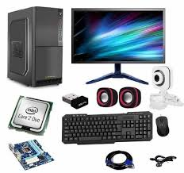
What is a Computer
A computer is an electrionic devices that can accept process outputca information this information can be anything form text and number and vidoes
Understanding Hardware The physical Coponents:-
Cantral Processing Unit (CPU)
The brain of the computer responsible for performing calculations and instructions
Memory (RAM)
Temporary storage for date the CPU is actively using allowing for fast access
Storage Devices
Permoray storage for date such as hard devise solid state deives and flash drives

Slide 2
Exporing software the instructions and programs
Operathing system (OS) The foundation of a computer managing resources and providing user interface
Applications programs designed to perform specific taske like word processing web browsing or gaming
Drivers software that enables the os to communicate with hardawaere components
Input Devices Communicating with the computer
Keyboard used to enter tex numbers and commands
Mouse used to control the cursor on the screen interact with objects and navigate menus
Touchscreen Allows for direct interaction with the computer using touch gestures

Slide 3
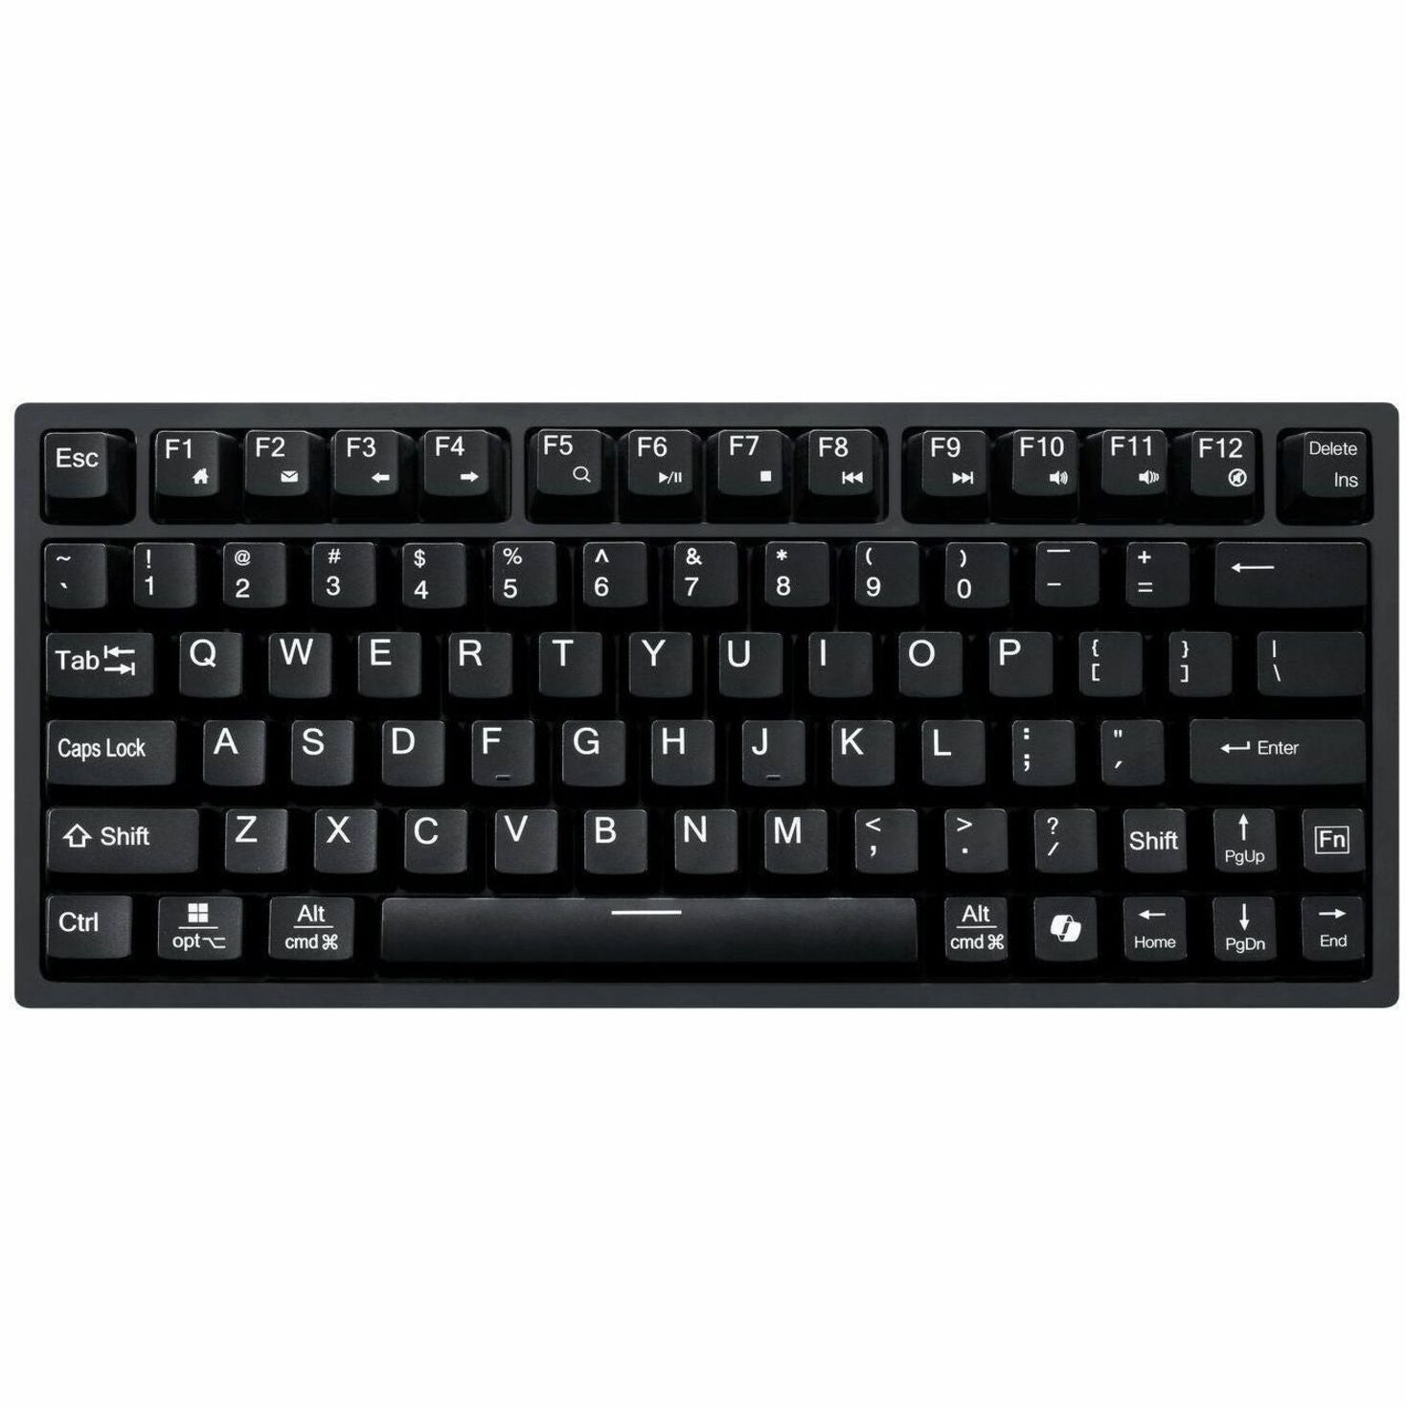
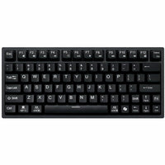
nput Devices Communicating with the computer
KEYBOARD
used to enter tex numbers and commands
Mouse used to control the cursor on the screen interact with objects and navigate menus
Touchscreen Allows for direct interaction with the computer using touch gestures

Slide 4
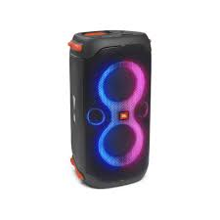
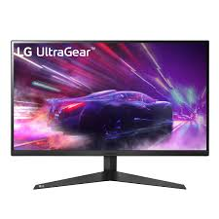
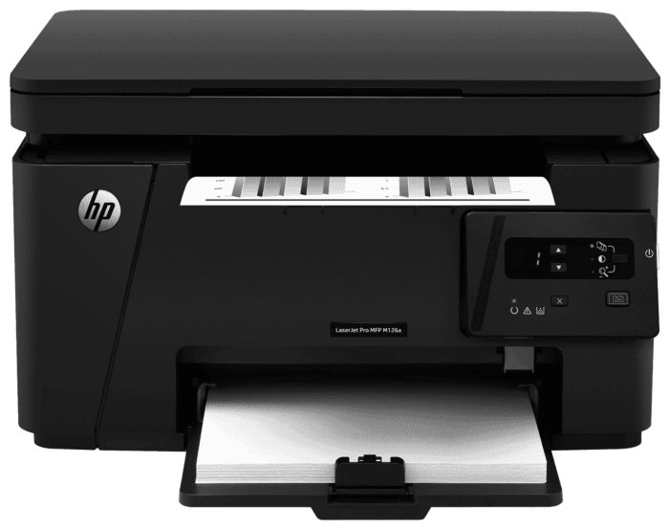
Output devices receiving information for the computer
Monitor Displays visual outpout including text images and videos
Speakers produce audio out put such as music sound effects voice
Printer Creates physical copies of documents images

Slide 5
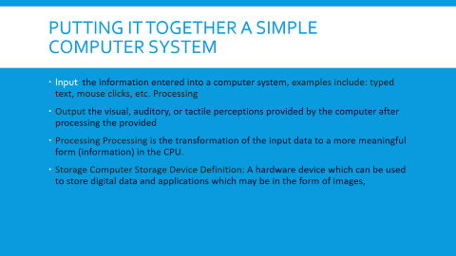
The relationship between hardware and software
Hardware
Software
It is manufactured.
Hardware cannot perform any task without software.
Difference between Hardware and Software - GeeksforGeeks

Slide 6
Putting it together a simple computer system
Input the information entered into a computer system, examples include: typed text, mouse clicks, etc. Processing
Output the visual, auditory, or tactile perceptions provided by the computer after processing the provided
Processing Processing is the transformation of the input data to a more meaningful form (information) in the CPU.
Storage Computer Storage Device Definition: A hardware device which can be used to store digital data and applications which may be in the form of images,

